Slide 1






BREAST CANCER
SC1015 Mini-Project
FCS6 Group 5
NG HOE PING (U2321991F)
ONG YAO SHENG (U2322398H)
EDMUND YEO ZI LONG (U2322794K)

Slide 2
Why Breast Cancer?
12.5% of all cancers globally
670k deaths in 2022

Slide 3
Who suffers from breast cancer?
IN 2023
297,790 cases in women
2,800 cases in men
Women are more susceptible to breast cancer

Slide 4
Our Team’s Agenda
01. Identifying Cancer Tumors
Determine whether it is “M” or “B”
(Malignant or Benign)
02. What affects survivability?
Inherent parameters that can’t be changed
E.g. Blood type
Modifiable parameters that can be changed
E.g. Smoking
We want to help a patient increase their survival rate
after determining it is malignant (cancerous) tumor

Slide 5
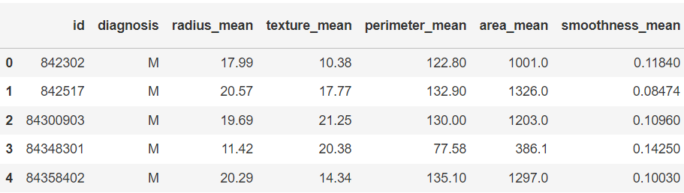
Sources from Kaggle
First
“Breast-cancer.csv”
“original”
To identify Malignant/Begnin tumors

Slide 6
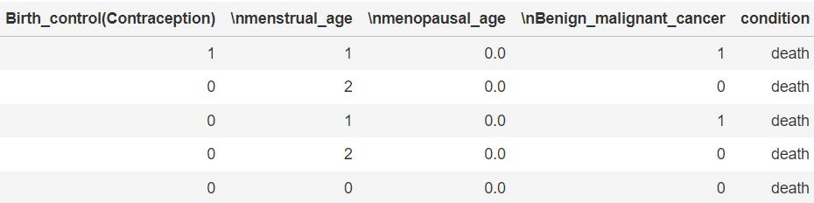
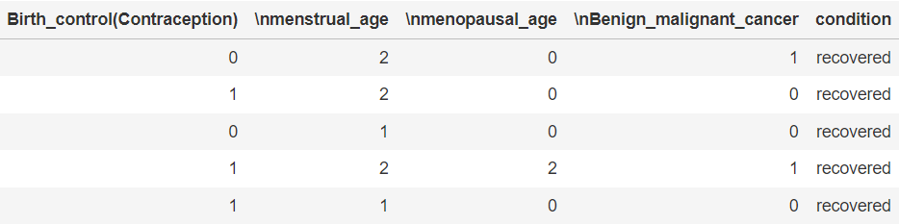
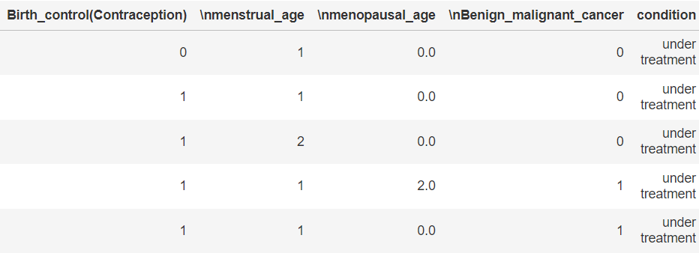
Sources from Kaggle
Second
“death.csv”
“recovered.csv”
“under-treatment.csv”
“death”
“recovered”
“undertreatment”
To identify parameters that affects survivability

Slide 7
Mean
Se
Worst
Average
Standard Error
Outliers
“Diagnosis”
(Classifies as “M” or “B”)
“Patient ID”
Radius
Texture
Perimeter
Area
Smoothness
Compactness
Concavity
Concave Points
Symmetry
Fractal Dimensions
Radius
Texture
Perimeter
Area
Smoothness
Compactness
Concavity
Concave Points
Symmetry
Fractal Dimensions
Radius
Texture
Perimeter
Area
Smoothness
Compactness
Concavity
Concave Points
Symmetry
Fractal Dimensions

Slide 8
Mean
Worst
Average
Outliers
“Diagnosis”
(Classifies as “M” or “B”)
Radius
Texture
Perimeter
Area
Smoothness
Compactness
Concavity
Concave Points
Symmetry
Fractal Dimensions
Radius
Texture
Perimeter
Area
Smoothness
Compactness
Concavity
Concave Points
Symmetry
Fractal Dimensions

Slide 9
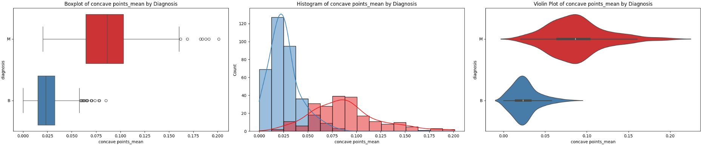
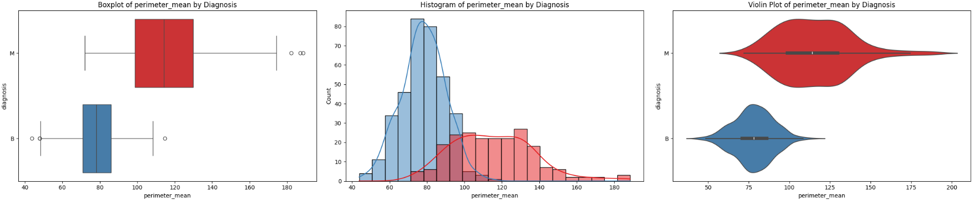
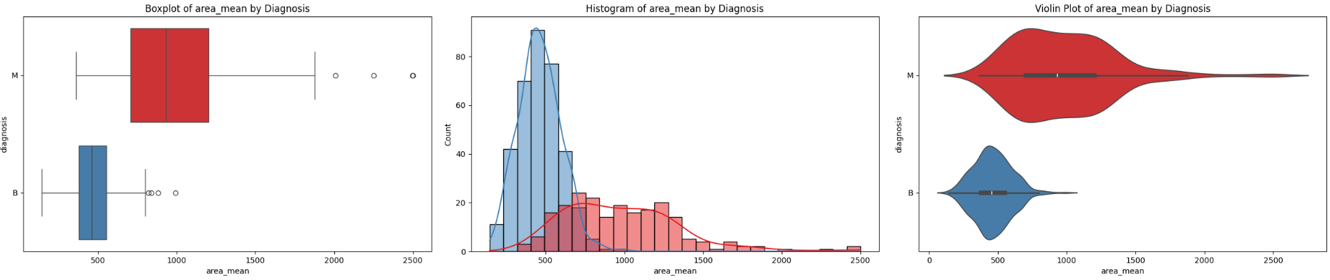
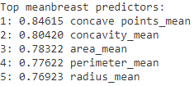
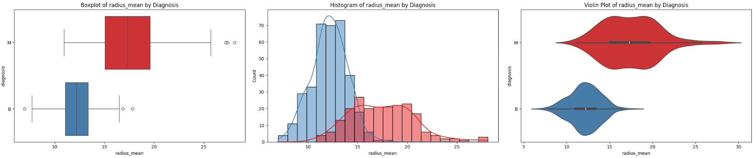
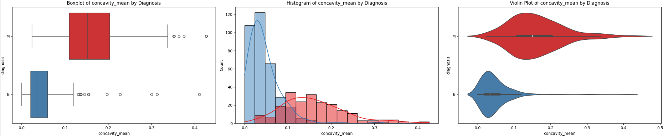
Mean

Slide 10
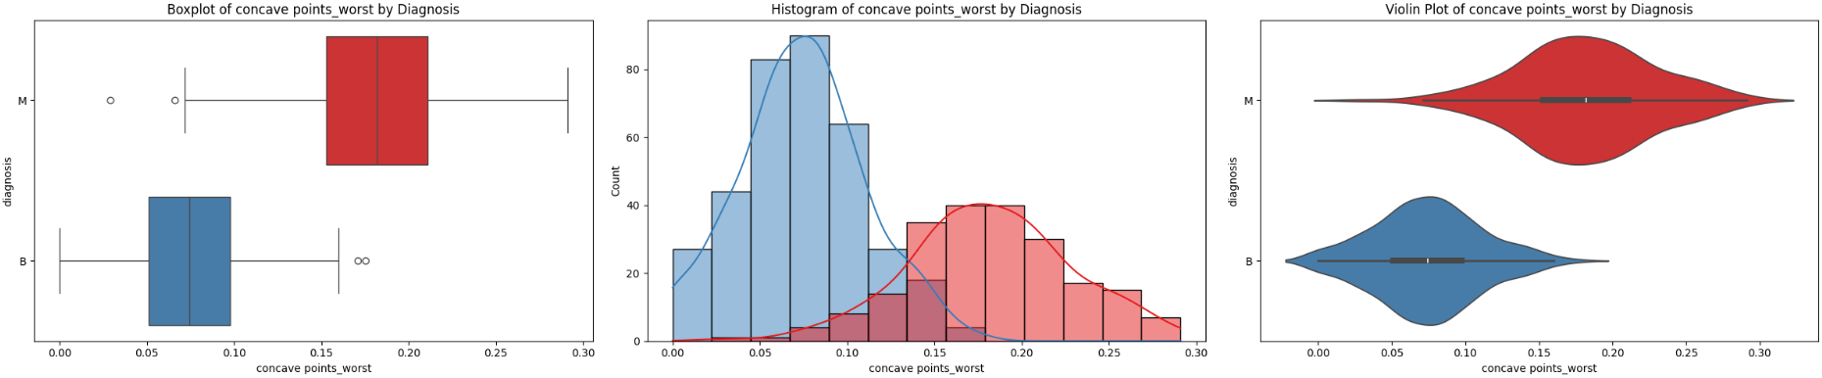
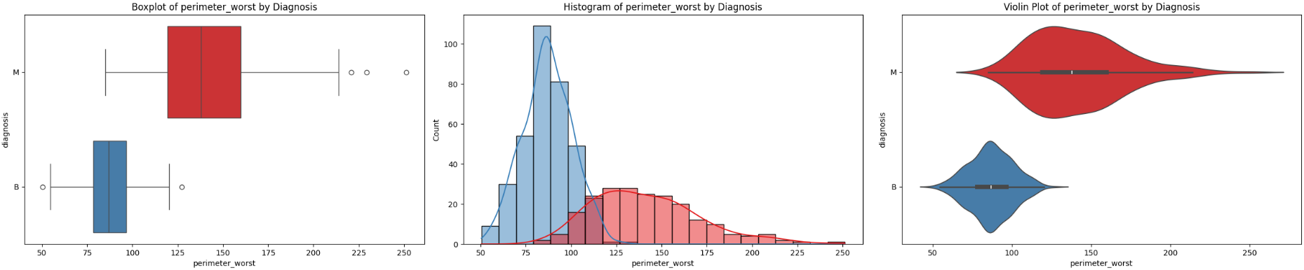
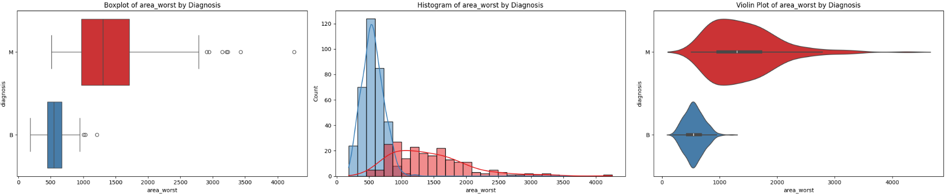
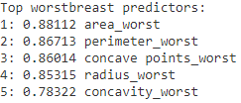
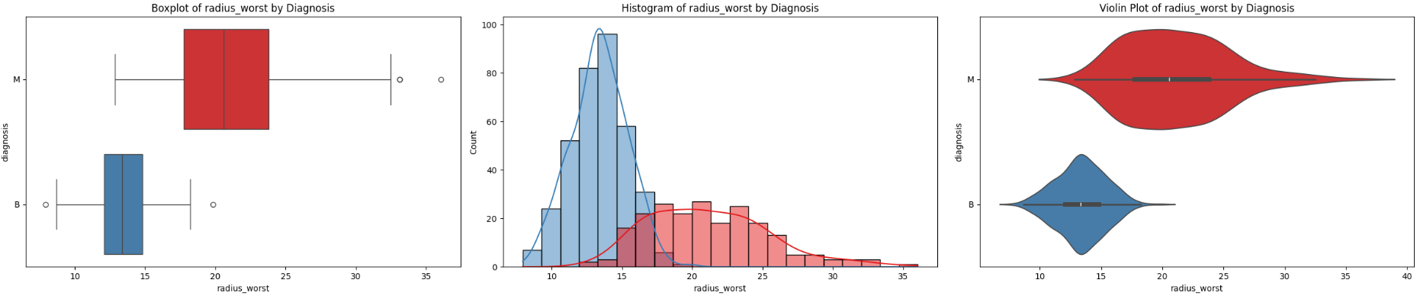
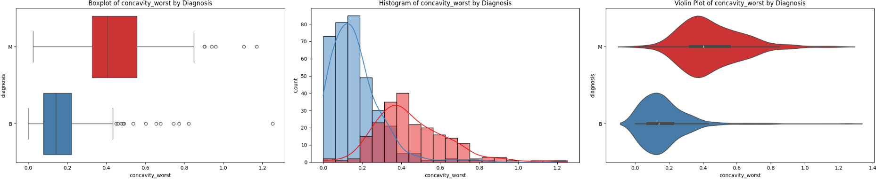
Worst

Slide 11
01. Females only Dataset
Removed all male data
02. Removed irrelevant parameters
Patient ID
Education
Second Source
Death
Recovered
Under Treatment
03. Combined “Death” and “Recovered”
into “survival” to use machine learning
04. One-hot encoding
Death => “1”
Recovered => “0"

Slide 12
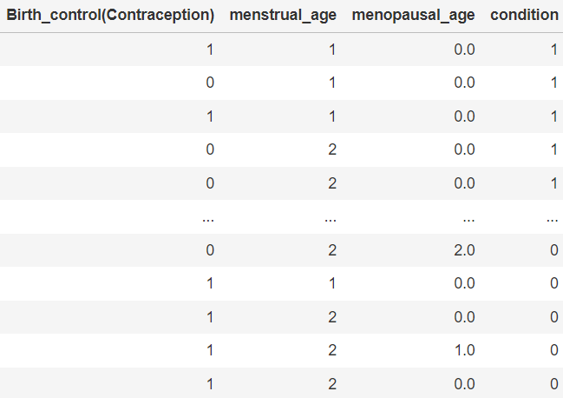
Before
After

Slide 13
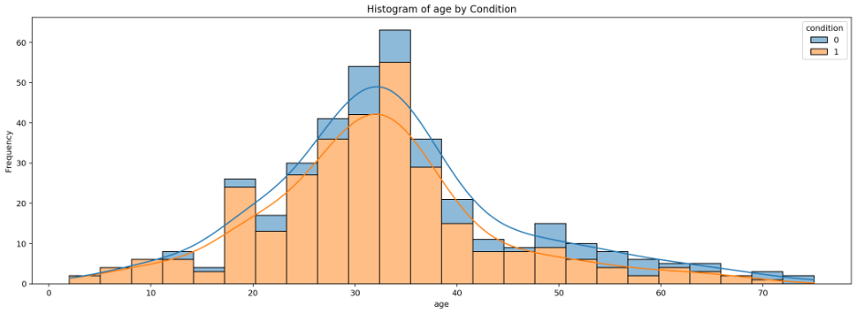
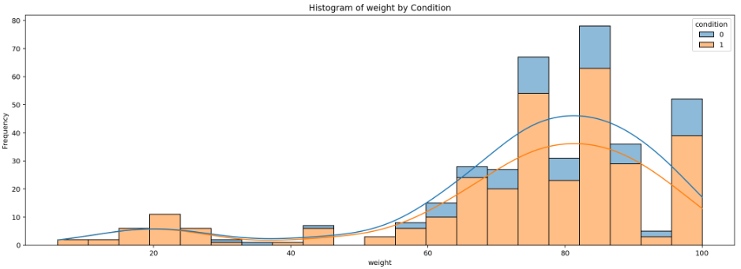
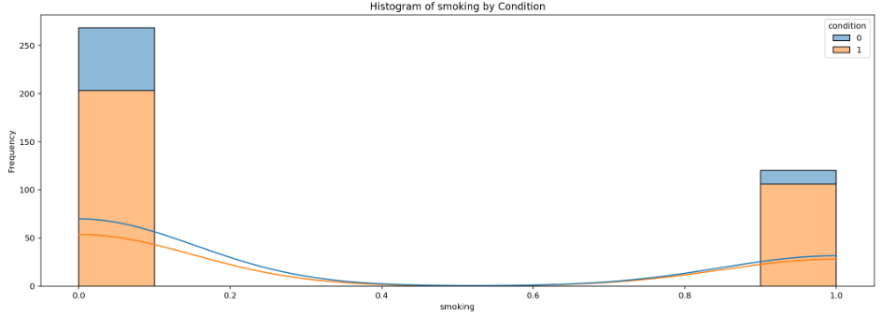
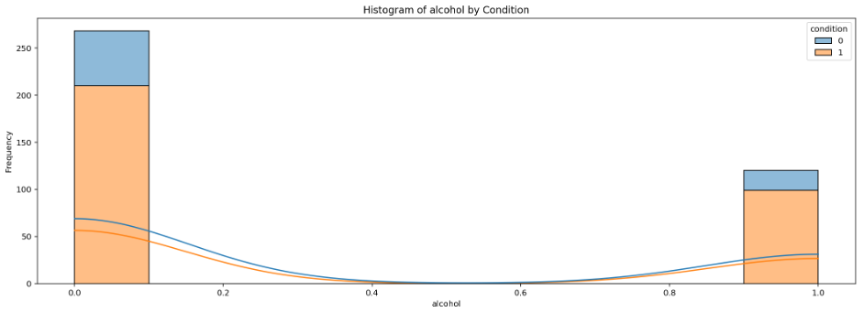
Age
Weight
Smoking
Drinking

Slide 14
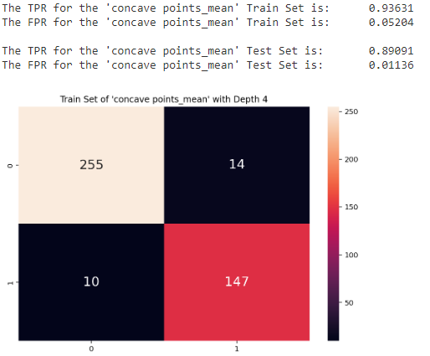
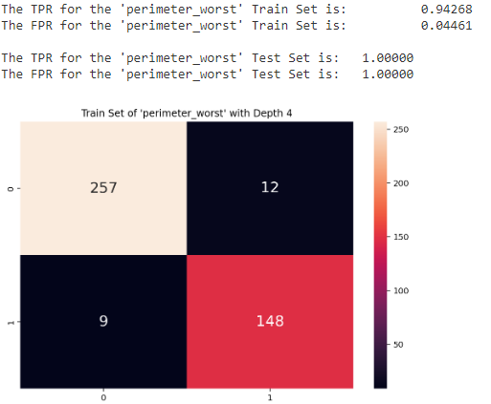
Applying Machine Learning on “original” Dataset
Aim for categorical outcomes from our numerical feature dataset
Decision Tree (Depth 4)
Highest Accuracy for “mean”
“Concave points”: Accuracy of 0.94366
Highest Accuracy for “worst”
“Perimeter”: Accuracy of 0.9507

Slide 15
Applying Machine Learning on “original” Dataset
Aim for categorical outcomes from our numerical feature dataset
Decision Tree (Depth 4)
RandomForest Classifier
Highest Accuracy for “mean”
“Concave points”: Accuracy of 0.94366
Highest Accuracy for “mean”
“Concave points”: Accuracy of 0.84615
Highest Accuracy for “worst”
“Perimeter”: Accuracy of 0.9507
Highest Accuracy for “worst”
“Area”: Accuracy of 0.88112
Although the accuracy decreased,
We have overcome the problem of being overfitting
Uphold the accuracy and prediction of correct classification

Slide 16
Applying Machine Learning on “survival” Dataset
Aim for categorical outcomes from our numerical feature dataset
Classifiers we used
01. Logistic Regression
02. K-Nearest Neighbours (KNN)
03. Support Vector Machine (SVM)
04. Normal Decision Tree
05. RandomForest Classifier
06. Gaussian Naive Bayes (NB)

Slide 17
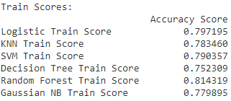
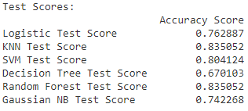
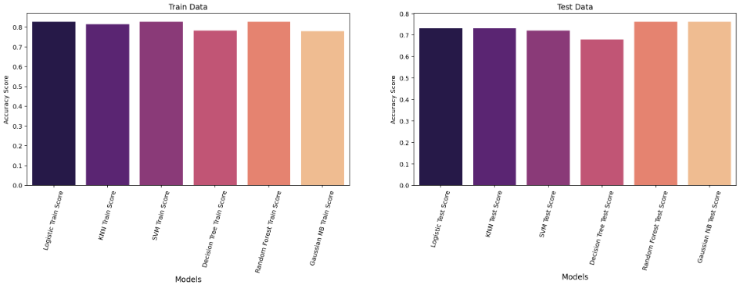
Applying Machine Learning on “survival” Dataset
Aim for categorical outcomes from our numerical feature dataset

Slide 18


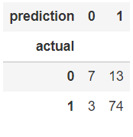
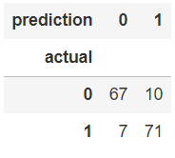
Applying Machine Learning on “survival” Dataset
Aim for categorical outcomes from our numerical feature dataset
Before SMOTE
After SMOTE

Slide 19
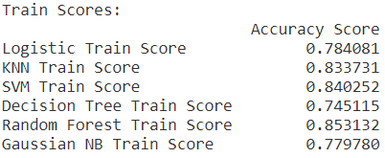
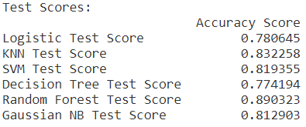
Applying Machine Learning on “survival” Dataset
Aim for categorical outcomes from our numerical feature dataset
Before SMOTE
After SMOTE
RandomForest Classifier is still remains the best model

Slide 20


Applying Machine Learning on “survival” Dataset
Aim for categorical outcomes from our numerical feature dataset
Multilayer Perceptron (MLP)
Keras Neural Network Model
RandomForest Classifier
Insufficient Data for Deep Learning Model. RandomForest is still more accurate

Slide 21
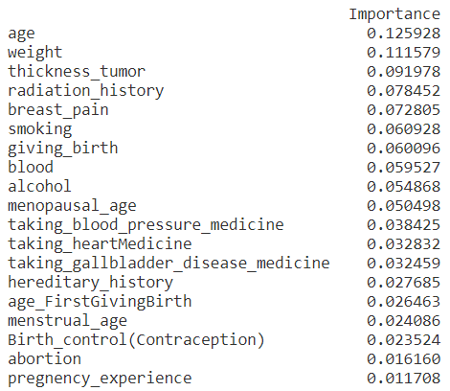
Applying Machine Learning on “survival” Dataset
Aim for categorical outcomes from our numerical feature dataset
RandomForest Classifier
Top 3 Variables for survivability
Top 3 Modifiable Risks to increase survivability

Slide 22
What we learned
Using different machine learning such as:
Random Forest
K-Nearest Neighbors Classifier (KNN)
Support Vector Classifier (SVC)
Gaussian Naive Bayes
Synthetic Minority Overlapping Technique (SMOTE)
Multilayer Perceptron (MLP)
Keras Neural Network Model

Slide 23
Outcome of Project
By using machine learning, patient can:
Predict if the breast tumor is cancerous (self-diagnosis)
What characteristic or habits to reduce/stop, to increase survivability of breast cancer

Slide 24
In conclusion, these are the data-driven insights:
Patients can self-examine by looking at the 5 features (concave points, area, perimeter, radius, and concavity)
Be aware and be diagnosed earlier
Avoid smoking and drinking
Eat healthy and live an active lifestyle

Slide 25


